Slide 1

Control Systems and Sensors

Slide 2

Kahoot Review
Topics/Definitions Covered
Microprocessors
ESP 32
Code
Functions
Loops
Variables
Integers
Floating Points
Strings
Booleans
Energy
Voltage
Current
Resistors
Sensors
Code
Syntax
Arguments
PinMode
DigitalWrite
Void Loop
Void Setup
Delay

Slide 3
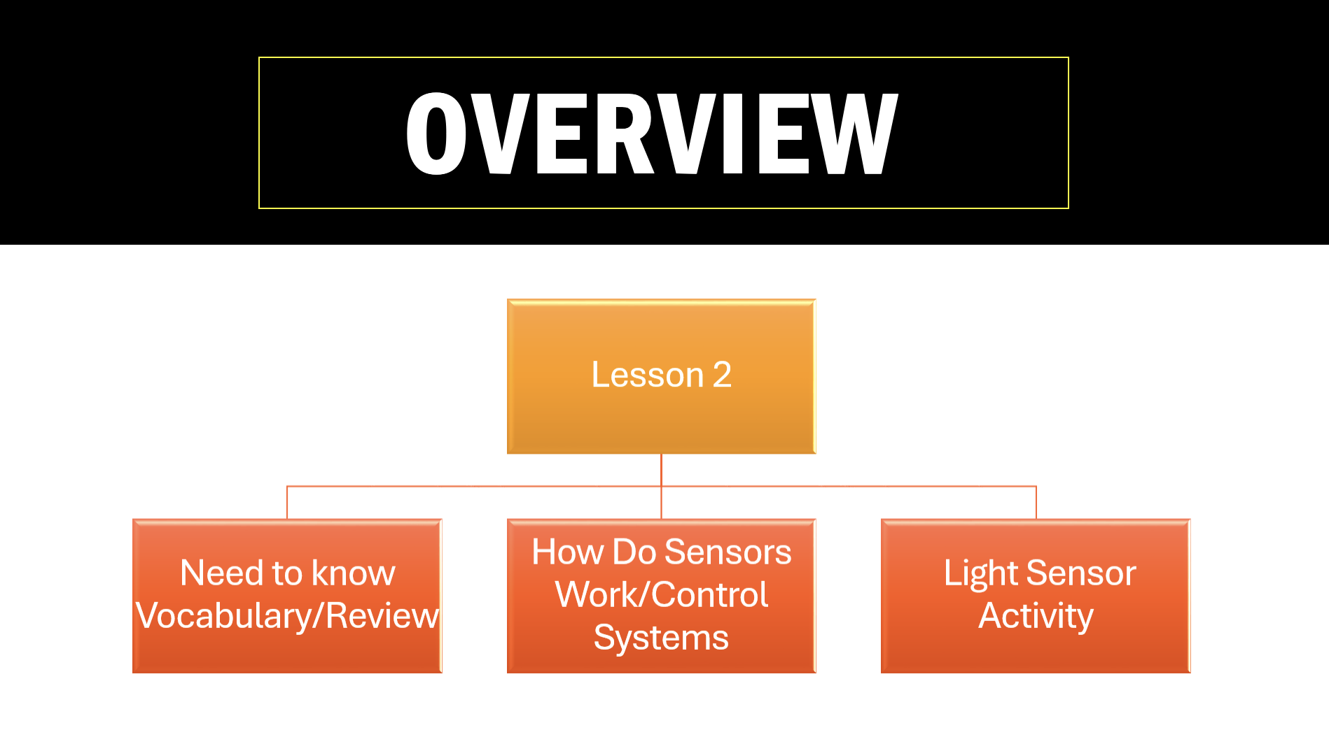

Slide 4
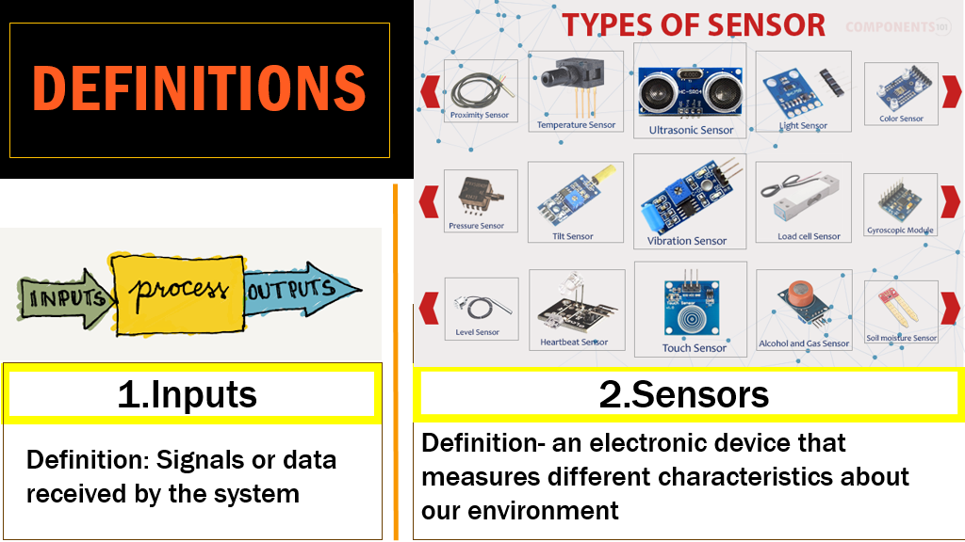

Slide 5
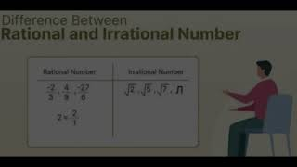
HOW DO SENSORS WORK ?

Slide 6
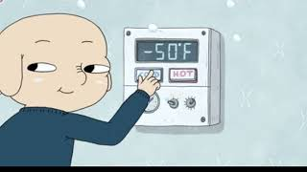
CONTROL SYSTEMS

Slide 7
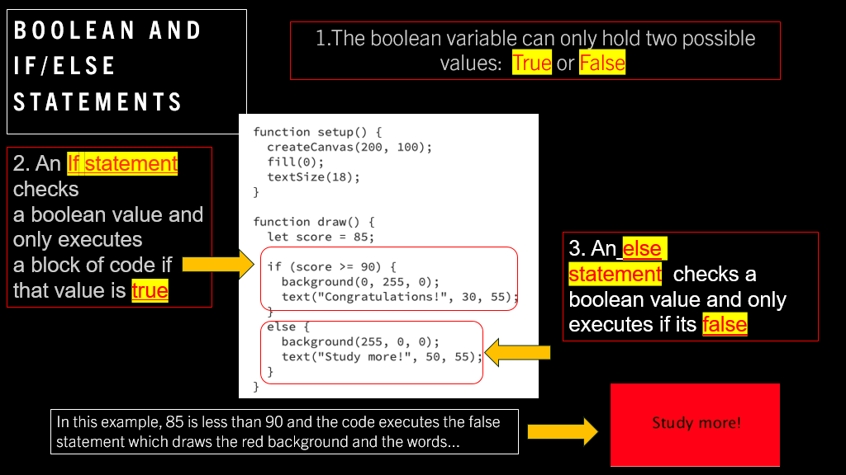
HOW DO SENSORS WORK ?

Slide 8
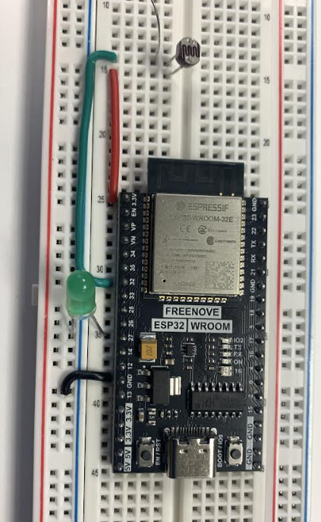
LIGHT SENSOR
Lesson 2 Activity

Slide 9
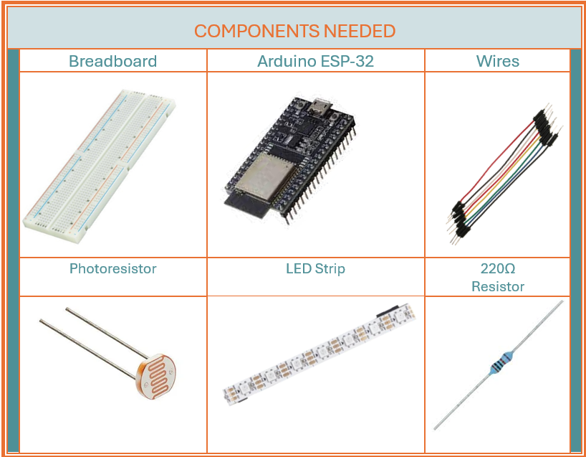

Slide 10
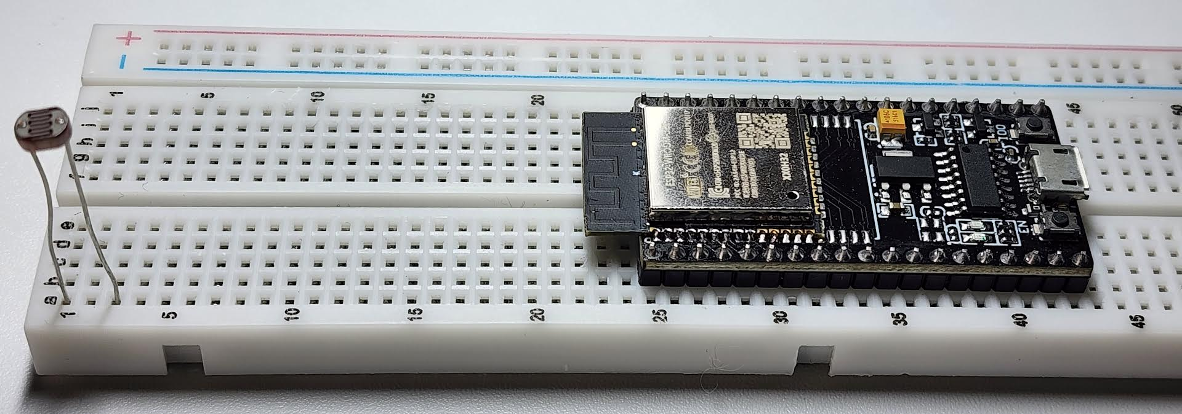
Place the photoresistor onto the breadboard with each pin on its own row​
(a1 & a2 on the right breadboard)​ ​
Next to the ESP32​
(b25-b43 on the right breadboard) ​

Slide 11
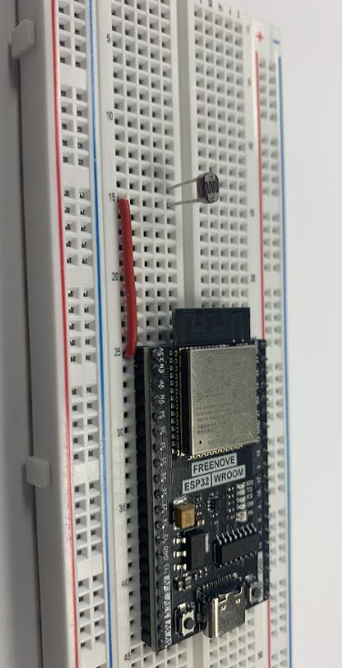
With a wire​
Connect one end of the photoresistor ​
to the 3.3V on the ESP32​
(b1 to a25)​

Slide 12
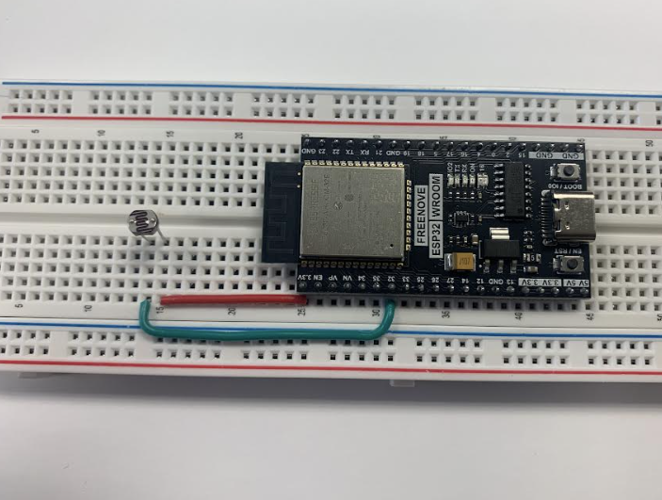
Using another wire connect the other pin of the photoresistor ​
(from a2)​
to GPIO 32​
(to a31) ​

Slide 13
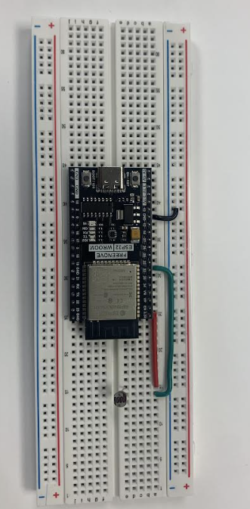
Connect a wire from GND to the negative (Blue) Power Rail

Slide 14
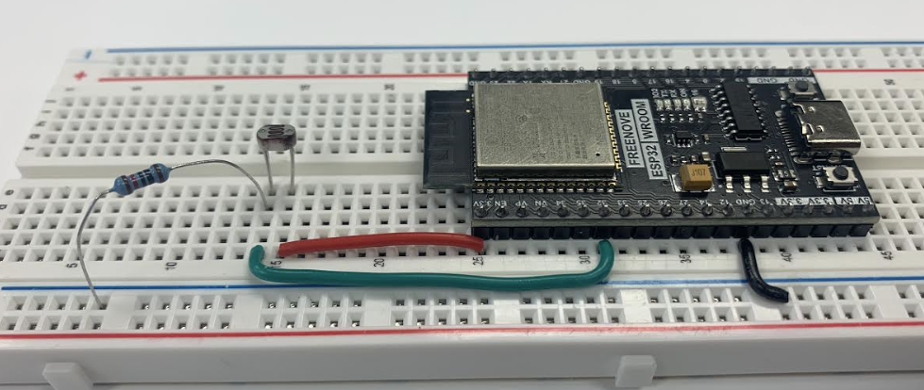
Connect a 10k Ohm resistor from the input pin of the photoresistor to the grounded Power Rail

Slide 15
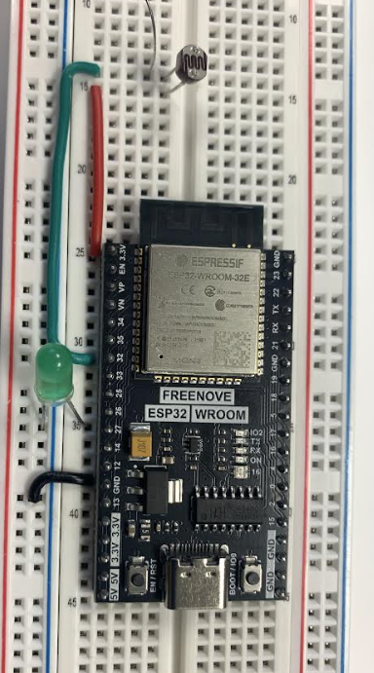
Connect an LED with the long pin connected to GPIO 27 and the short pin connected to GND.

Slide 16
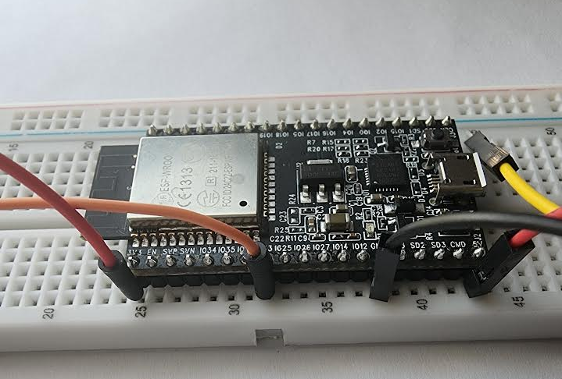
​Connect the red 5v wire to the 5v supply on the ESP32 (a44)​
​

Slide 17
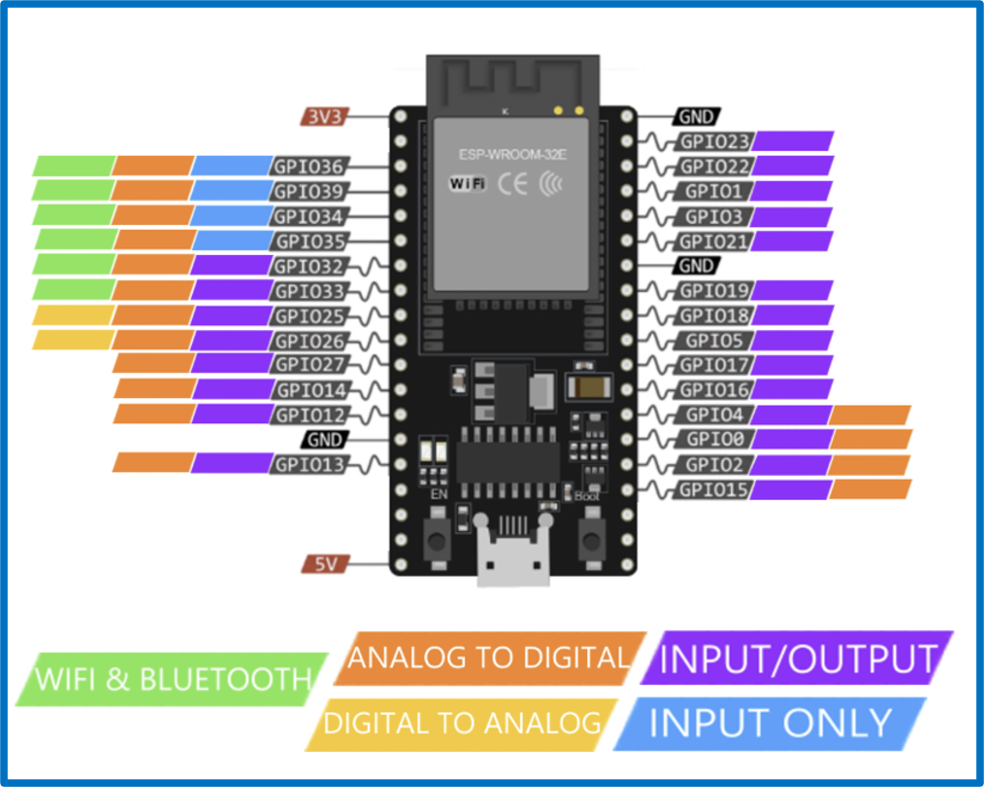

Slide 18
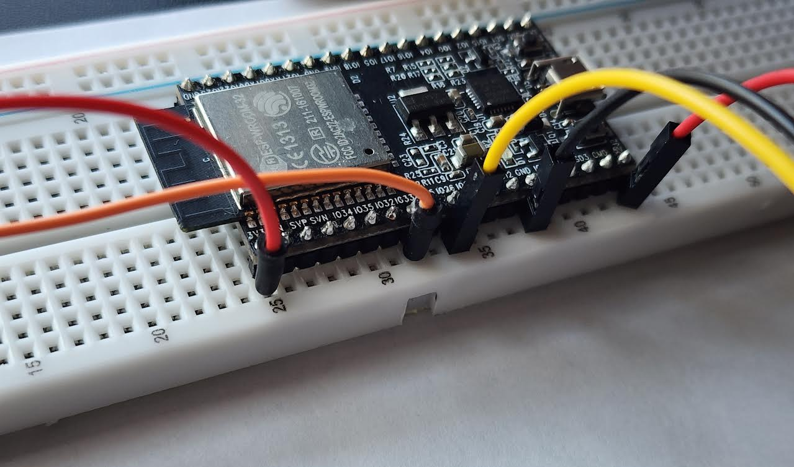
Connect the yellow DO(Digital Out) wire​ to the
GPIO 26 (a35)

Slide 19
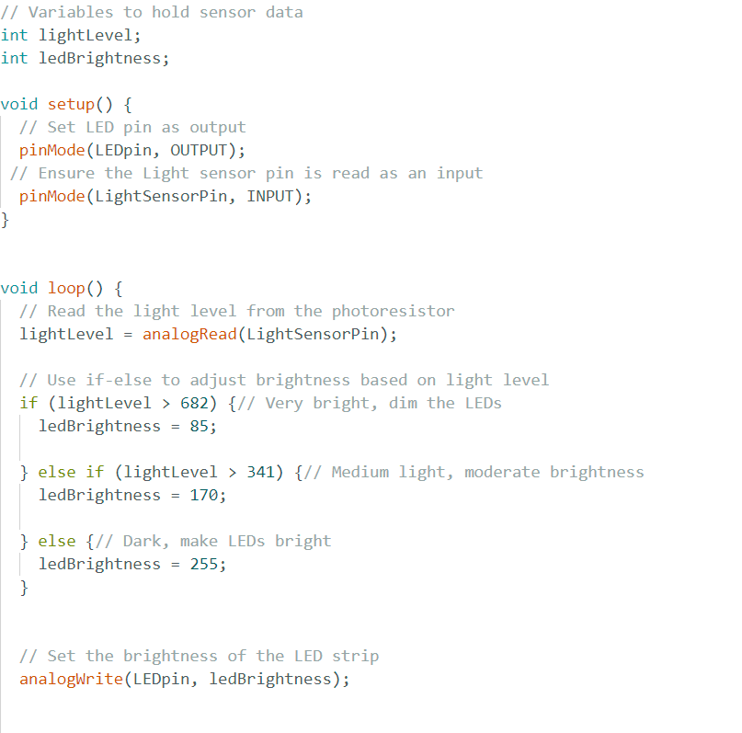
Code​
Setup

Slide 20
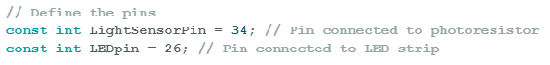
Let's start by labeling the pin we have connected arduino with a variable
Since we’re using more arduino pins, these variables we set will help us to not confuse where the sensors are

Slide 21
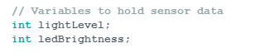
Set up the variables for the information our sensors will use as well
While we aren’t storing anything in these “boxes” we are letting the computer know these will hold integers

Slide 22
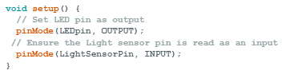
In the setup section
We’ll use the pinMode code to:
Set the LEDpin location that will be sending out energy as an
OUTPUT
Set the LightSensorPin location that will be taking in energy as an
INTPUT

Slide 23
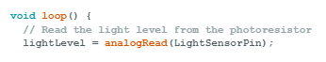
Then in the void loop, we want to:
And read the analog value with
analogRead
from…
Use the
lightLevel variable we made for an integer value
the
LightSensorPin

Slide 24
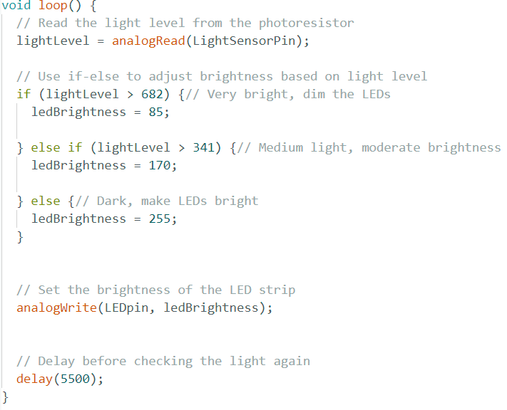
Then read the light level and adjust the output based on the sensor readings using
if
else if
else
Statements

Slide 25
Based on the value assigned to the ledBrightness from the conditions
We will then modify what level of energy sent will be sent to the pin

Slide 26
Lastly, we will wait for a few seconds before the code runs again
Notes:
Ask how many seconds (5500=5.5)

Slide 27
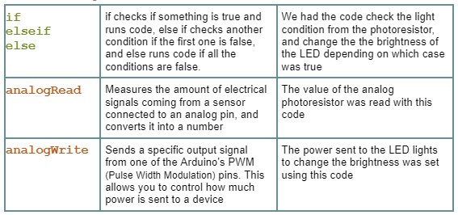

Slide 28
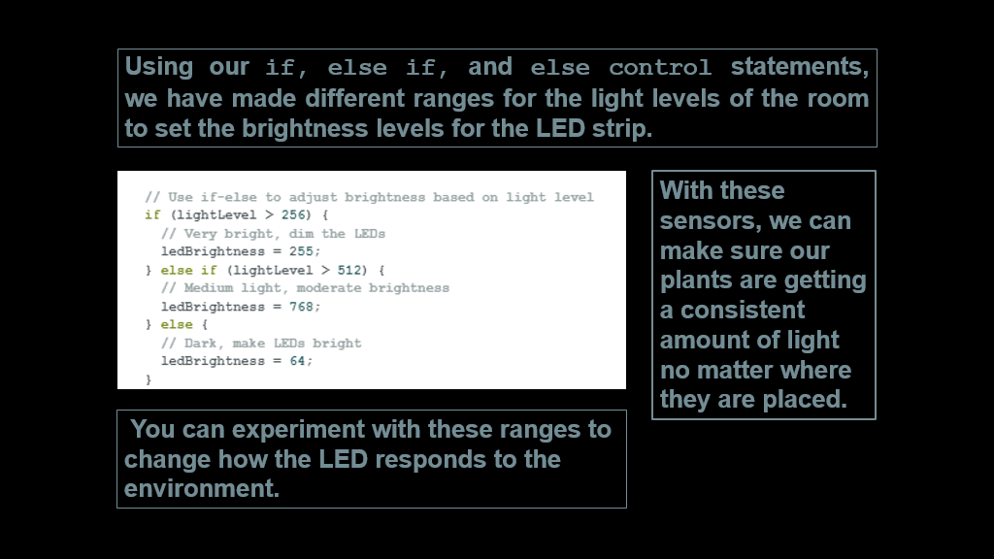

Slide 29
LESSON CHALLENGE
Incorporate the LED Strip to output different colors.
#1

Slide 30
LESSON CHALLENGE
Add more statements to make the LED strip react to more light levels
Note: The brightness of the LED strip can be set between 0 and 225
The photoresistors we are using read between 0 and 1023
#1

Slide 31
LESSON CHALLENGE
Add a resistor to the circuit (between the power and resistor)
What do you observe?
#1

Slide 32

LESSON REVIEW :
CONTROL SYSTEMS AND SENSORS
Topics/Definitions Covered: ​
Inputs
If statements /Else Statements
Sensors
Control Systems
Booleans
Photoresistors and LED strips​

